Slide 1
Yunshun Zhong
Research Update
09/06/2020

Slide 2
Summary of progress
Building damage and influence analysis for Beirut explosion
Wrote a brief introduction and outline of this project
Data Cleaning of the data from Frontline Engineers
Exploratory data analysis

Slide 3
Building damage and influence analysis for Beirut explosion (Please see my Jupyter Notebook for thorough and clearer information)
Objectives
Predict damage of each building according to available survey data.
Predict the damage of buildings to local communities.
Observe and predict how to recovery develops and the interaction between communities and infrastructure.

Slide 4
Progress1 Wrote a brief introduction and outline of this project
This project focus on measuring impact and building resilience in infrastructures and communities in Beirut and divided into three parts:
Predict damage of each building according to available survey data.
Predict the damage of buildings to local communities.
Observe and predict how to recovery develops and the interaction between communities and infrastructure.
The first part is divided into several steps:
Getting the data and data cleaning.
Exploratory data analysis.
Building machine learning models to predict building damage level.
Verify models using new data and model optimization.

Slide 5
Progress2 Data Cleaning of the data from Frontline Engineers
The dataframe has 298 rows and 64 columns. Some column names and damage levels has written in Lebanese which is not included in ASCII and will be removed for easier data analysis.
Building condition has 4 levels:
No Damage, No evacuation
Moderate Damage, repair needs to be done, No evacuation
Heavy Damage, Evacuation needed repairs should be done as soon as possible
Major damage, Evacuation needed for the Building and the Building nearby
Conditions for each part of the building, such as Building Entrance and Building Door has 4 levels:
Minor
Major
Severe

Slide 6
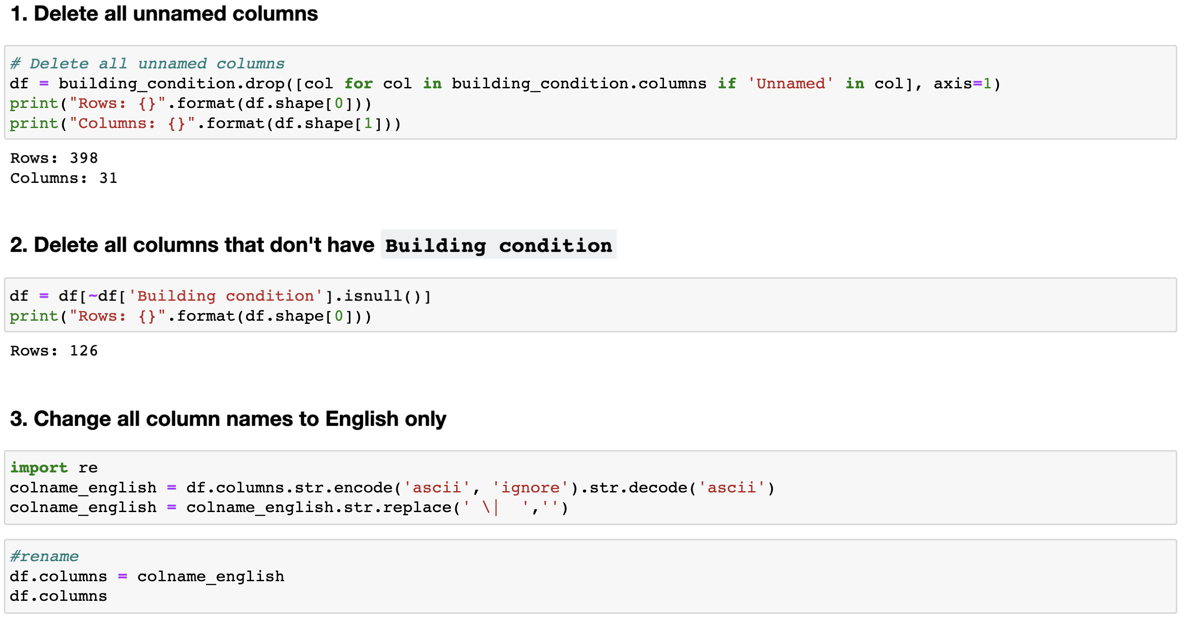
Progress2 Data Cleaning of the data from Frontline Engineers

Slide 7
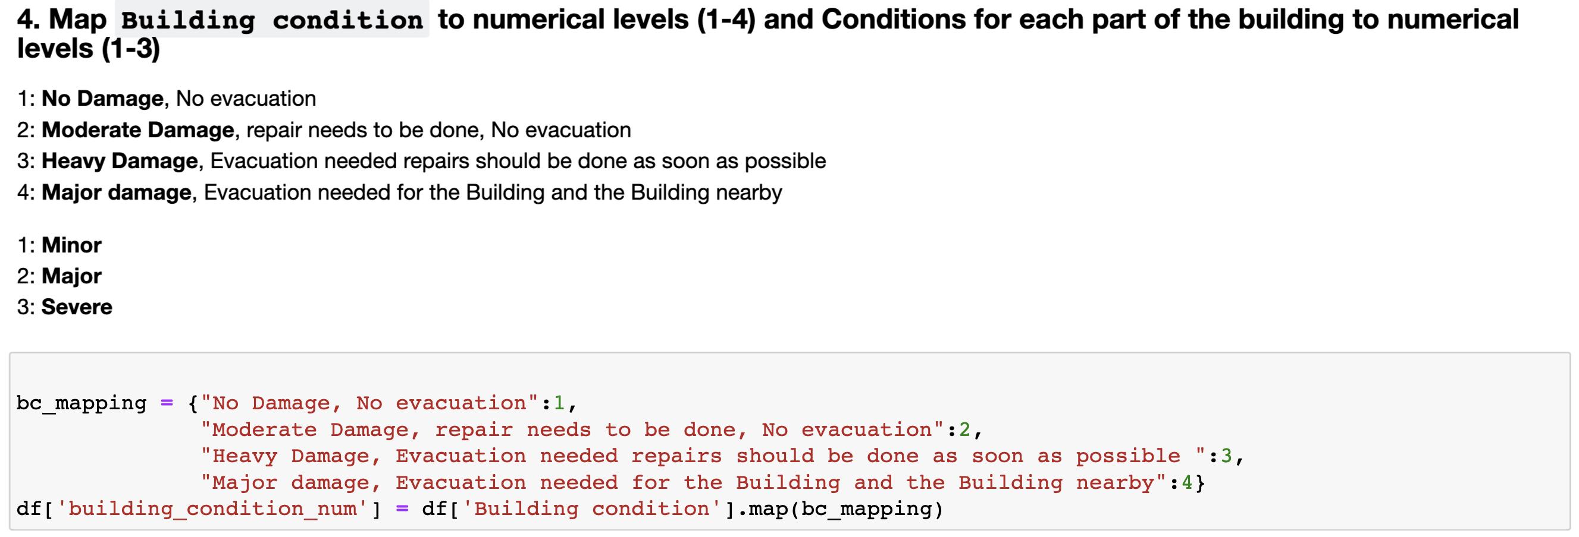
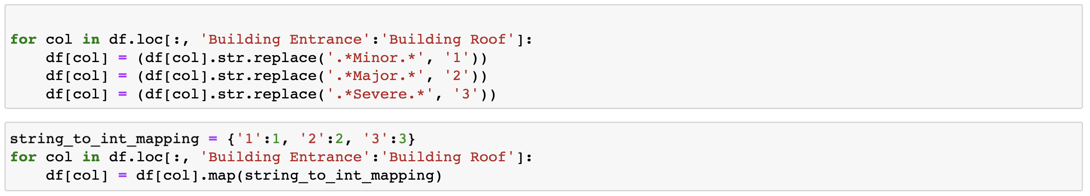
Progress2 Data Cleaning of the data from Frontline Engineers

Slide 8
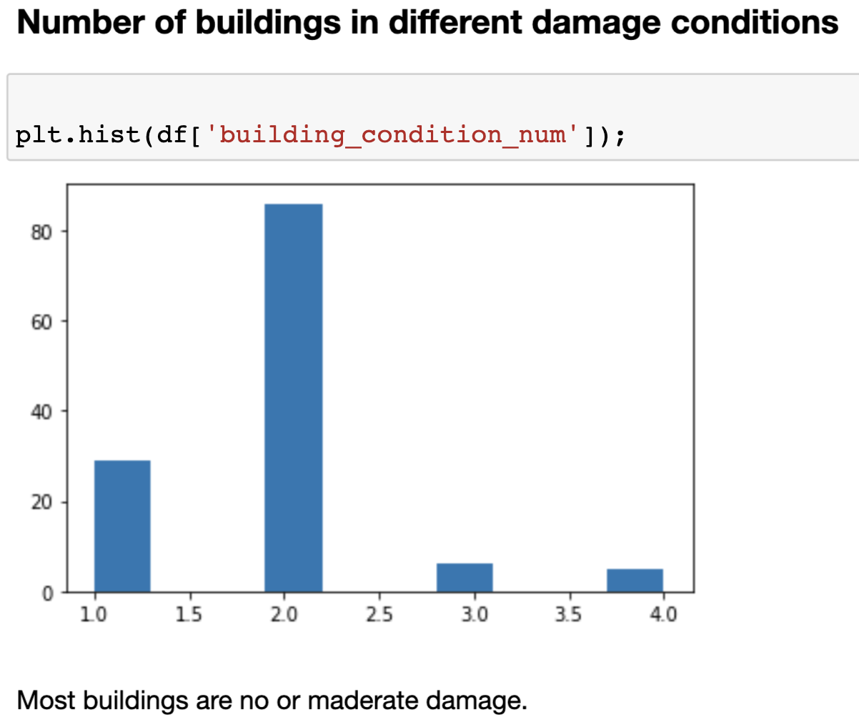
Progress3 Exploratory data analysis

Slide 9
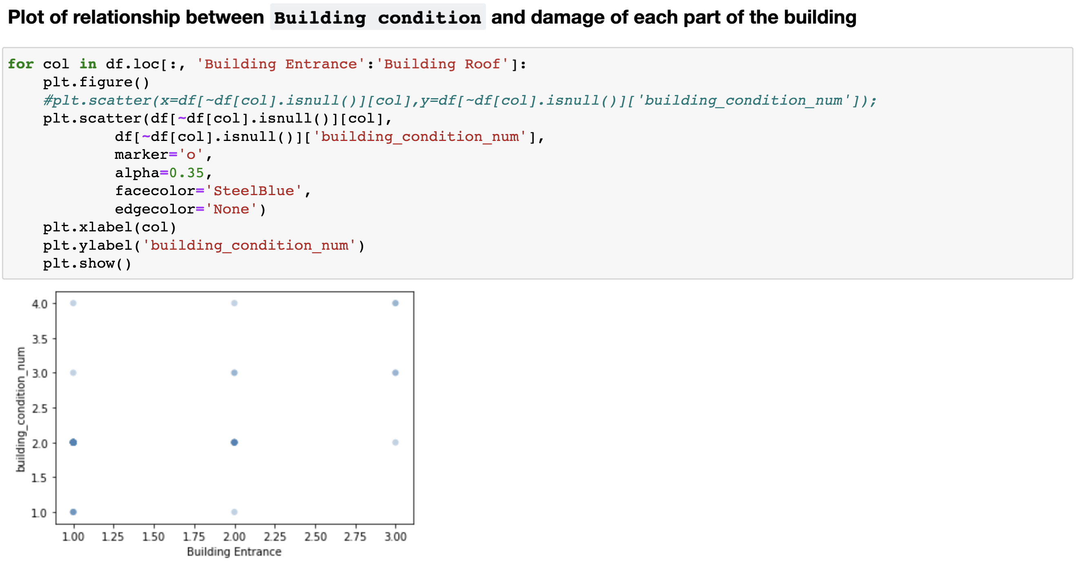
Progress3 Exploratory data analysis (see Jupyter Notebook for all graphs)

Slide 10
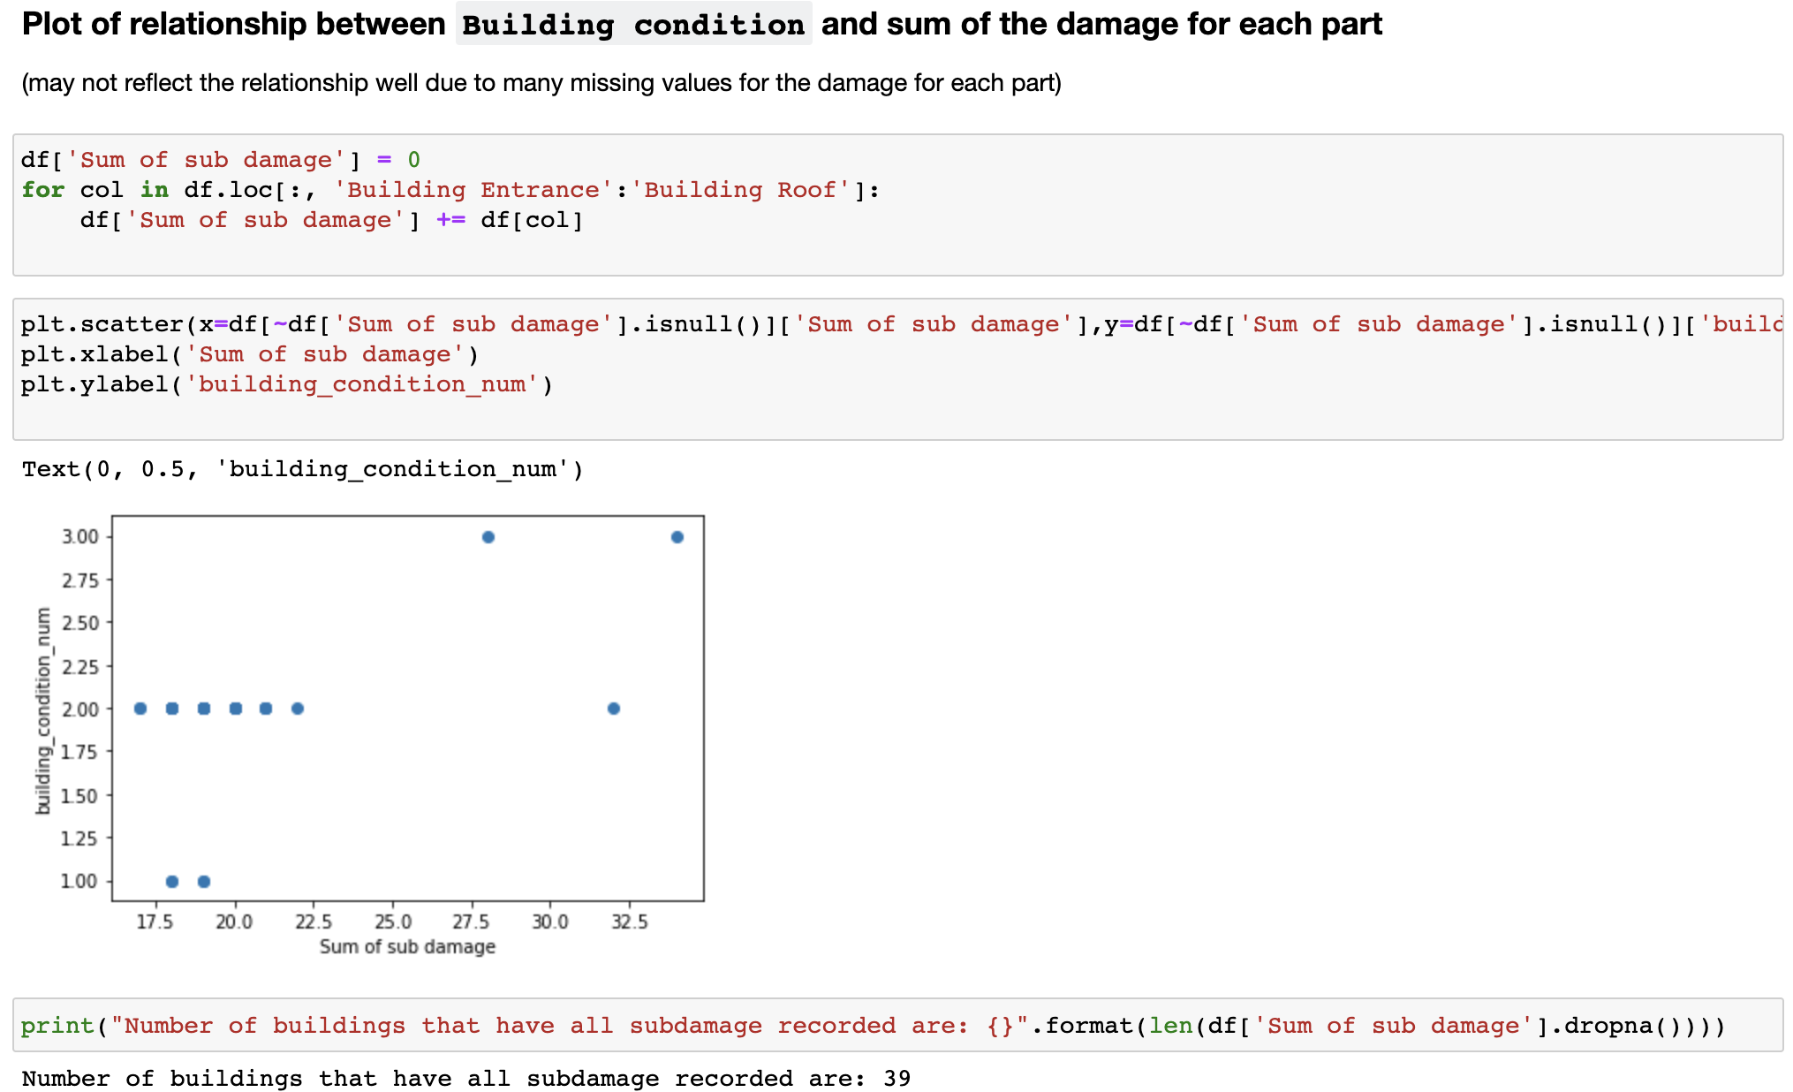
Progress3 Exploratory data analysis

Slide 11
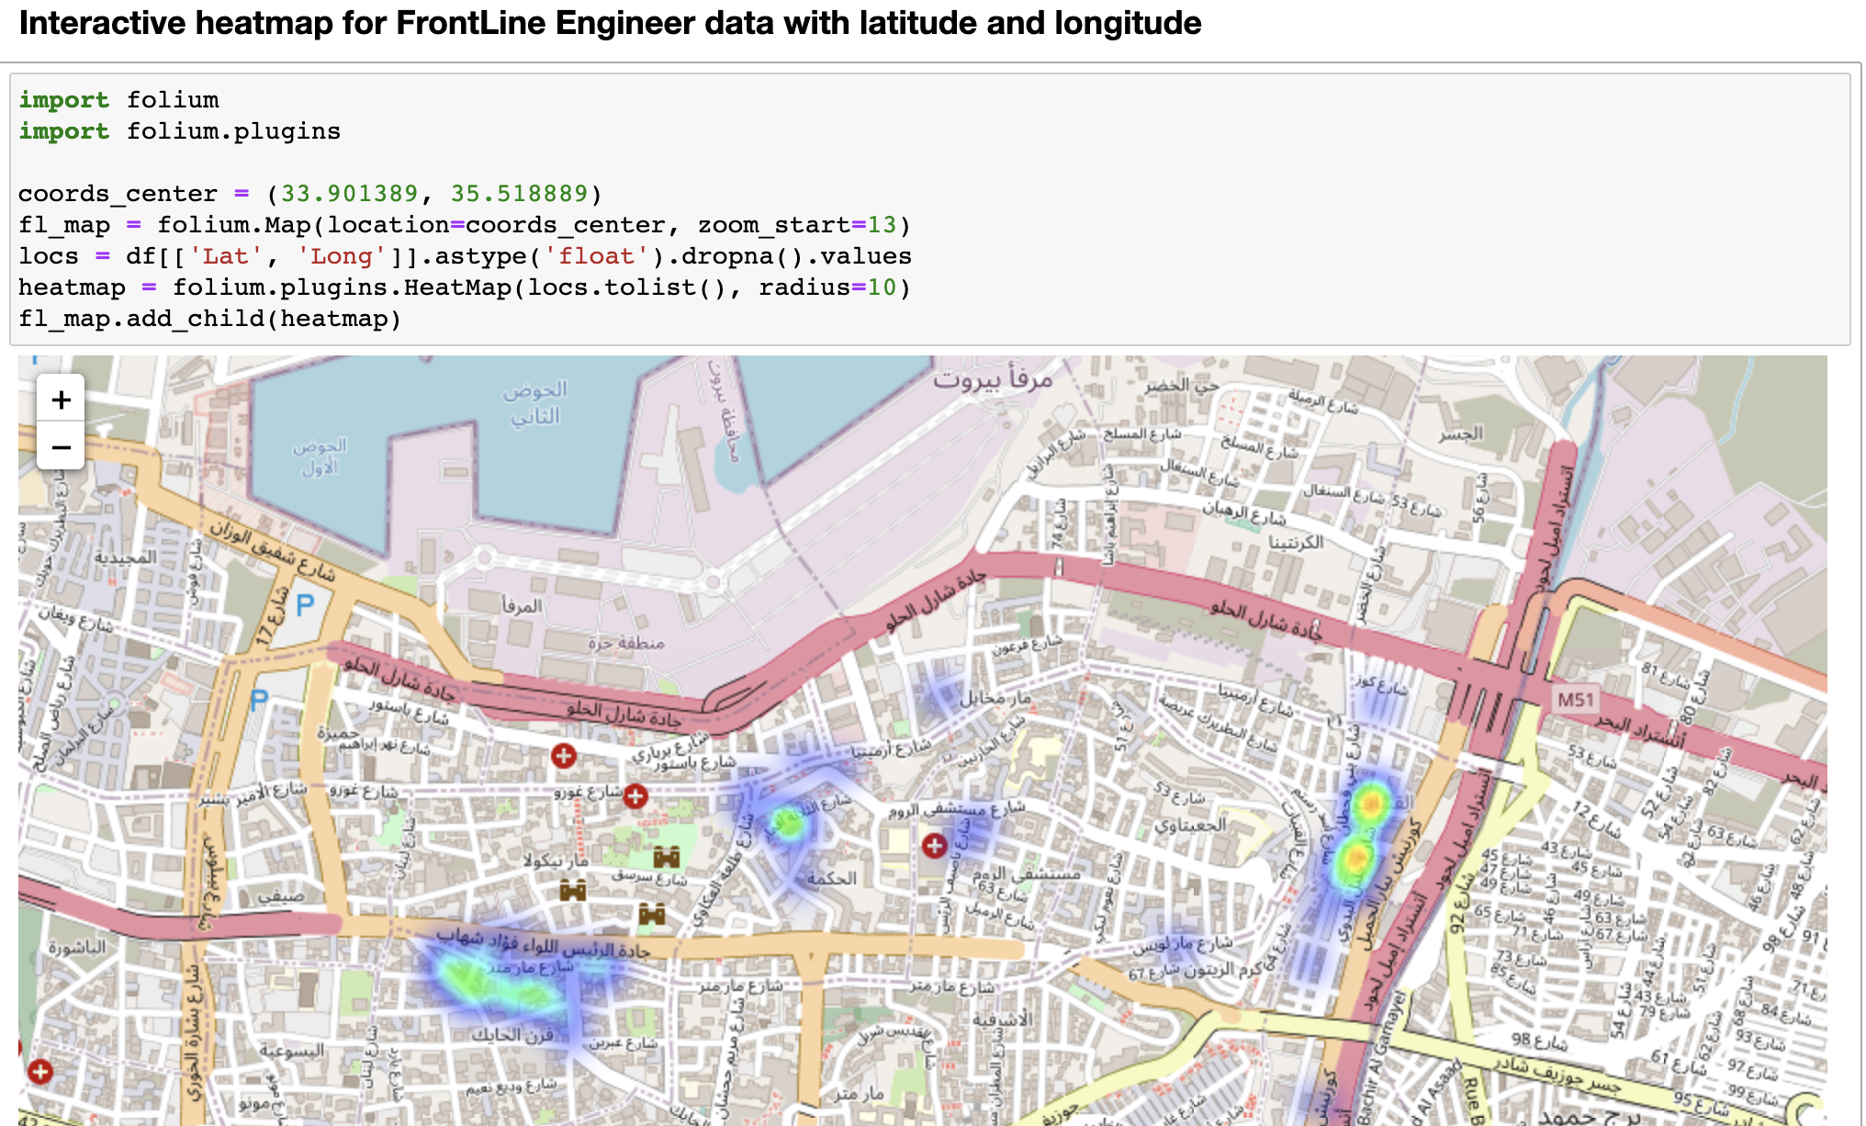
Progress3 Exploratory data analysis

Slide 12
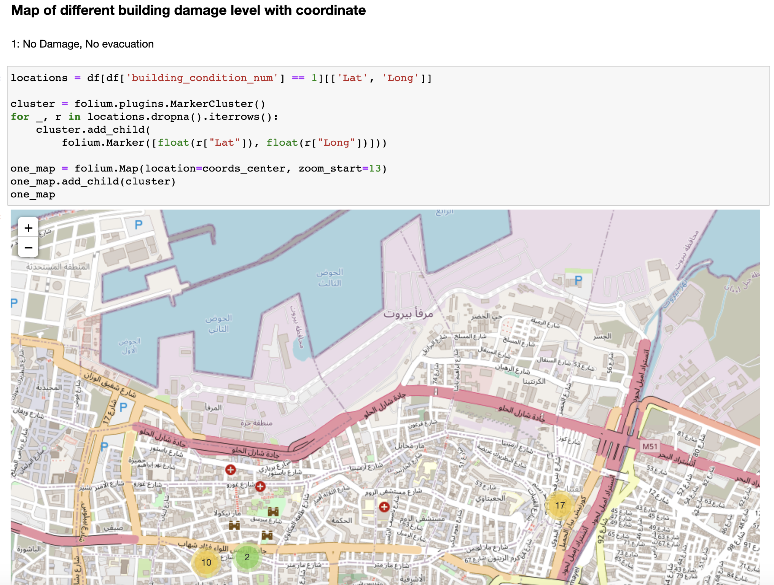
Progress3 Exploratory data analysis

Slide 13
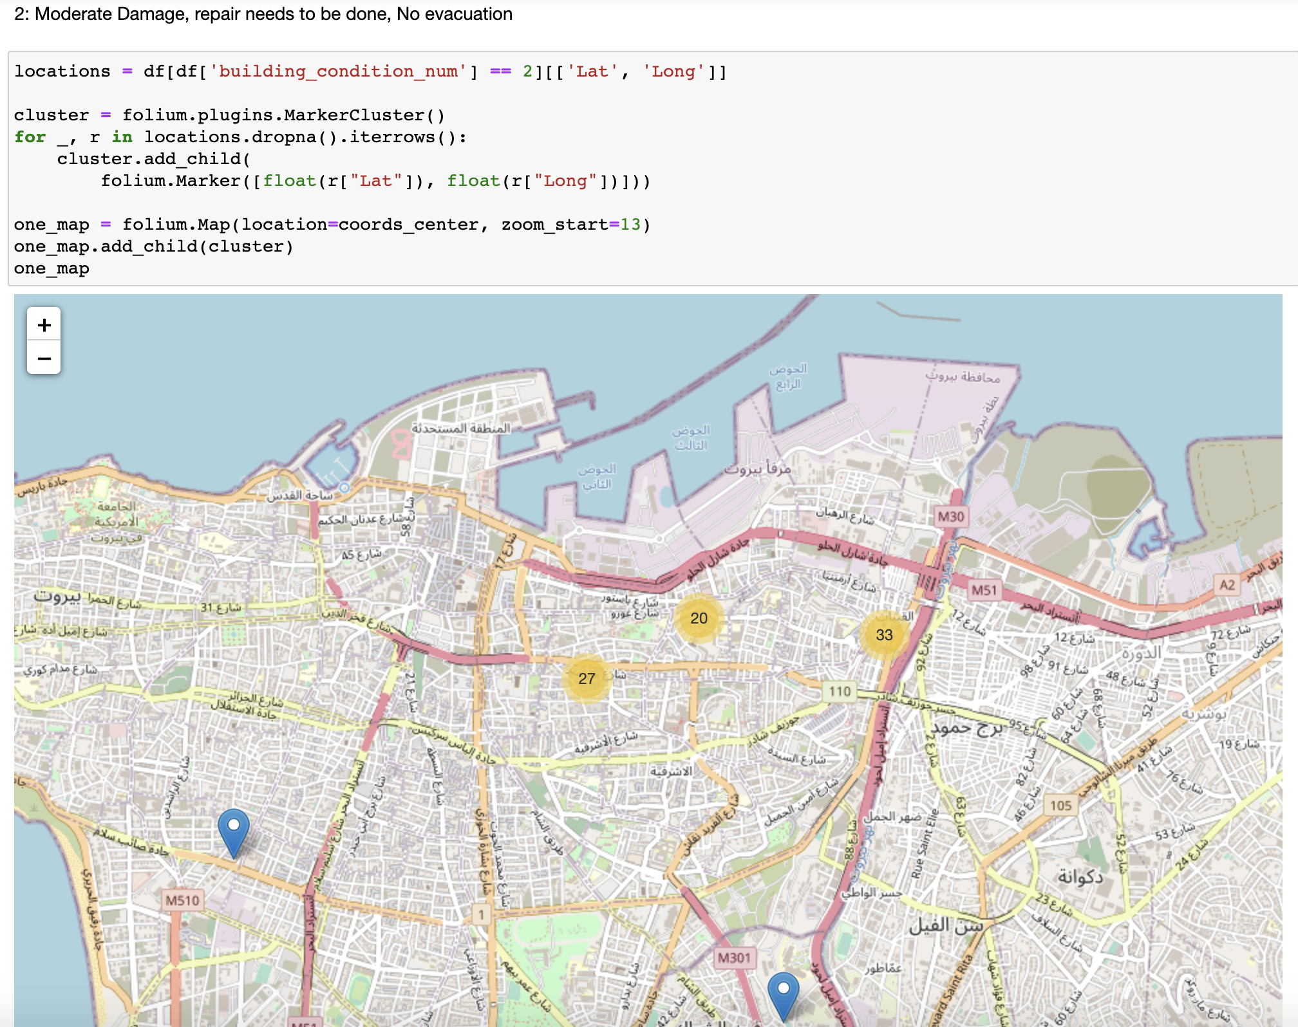
Progress3 Exploratory data analysis

Slide 14
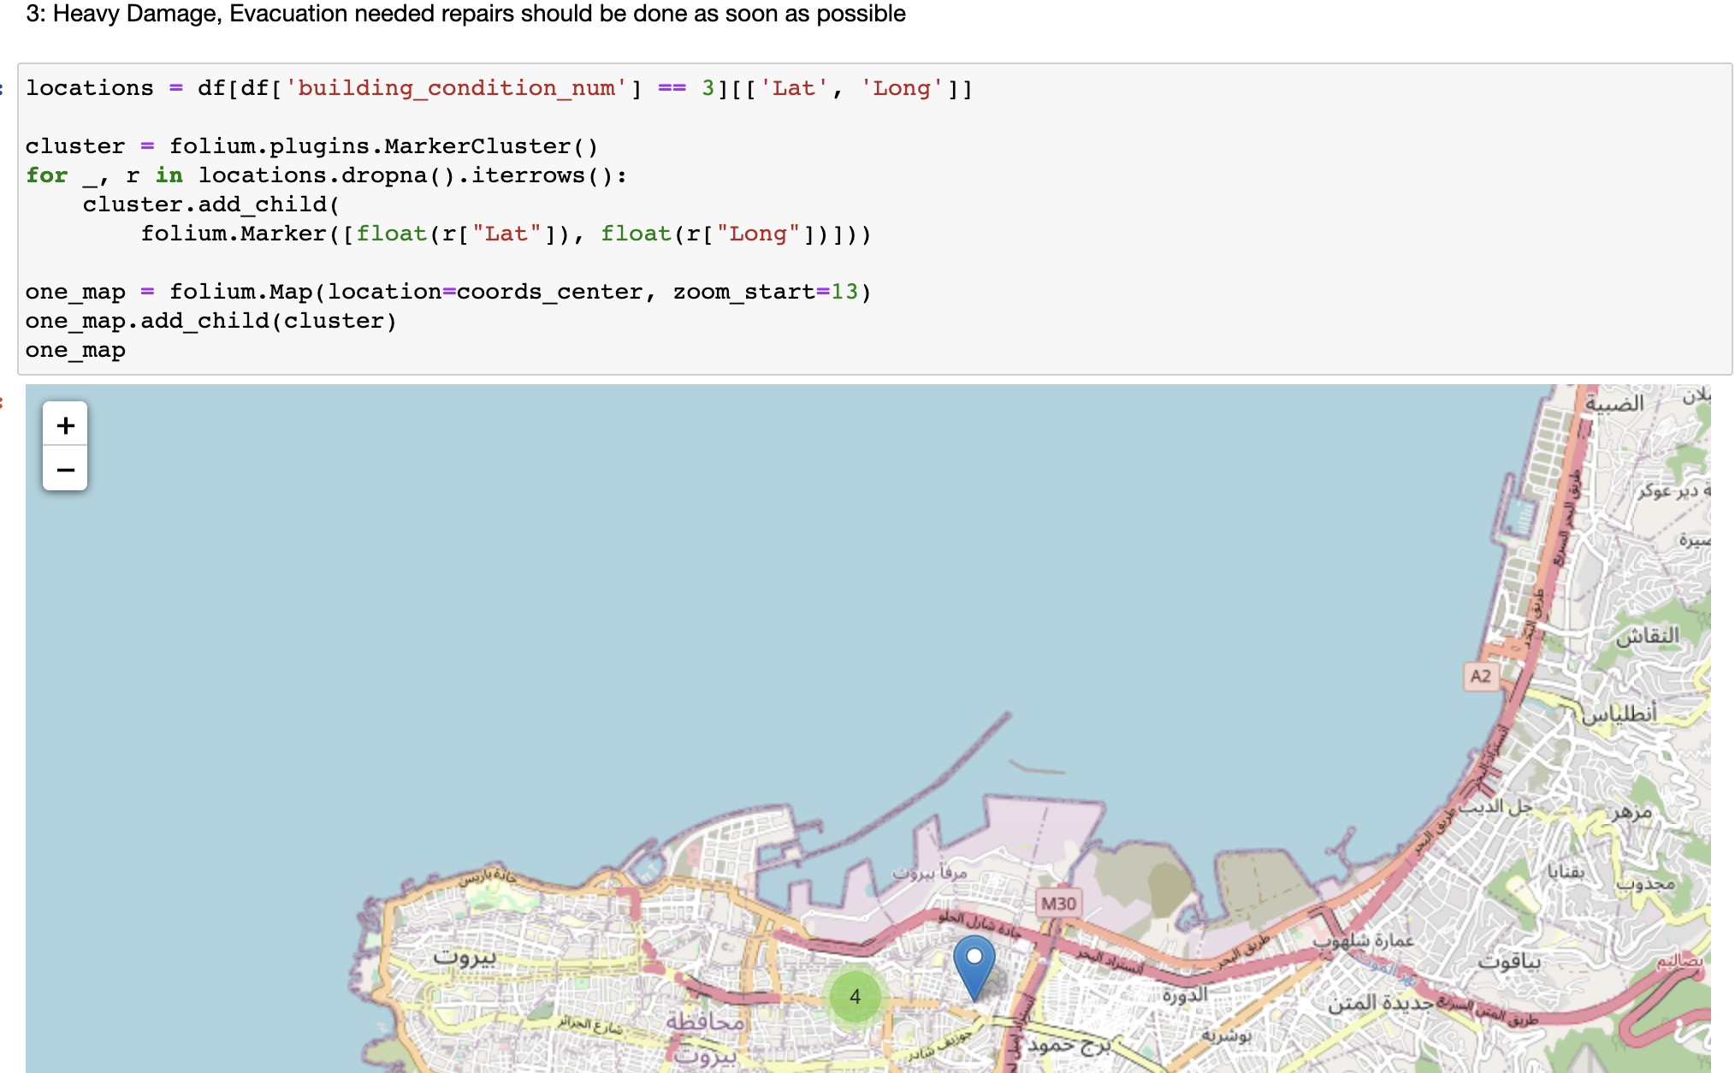
Progress3 Exploratory data analysis

Slide 15
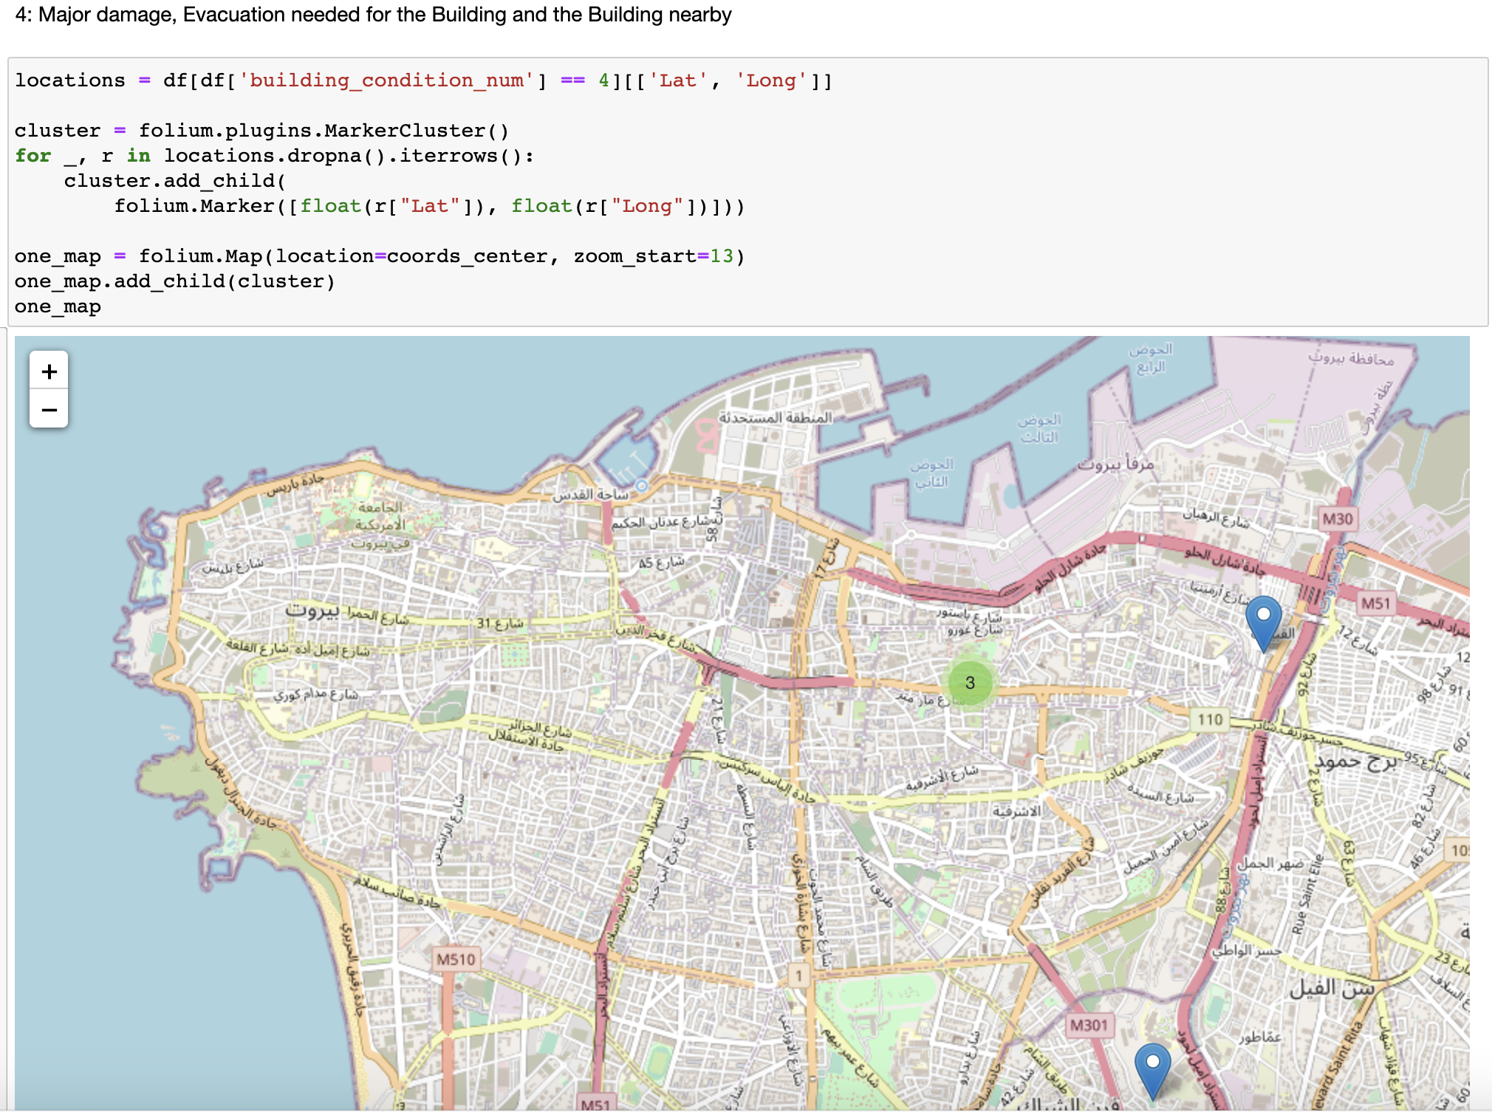
Progress3 Exploratory data analysis

Slide 16
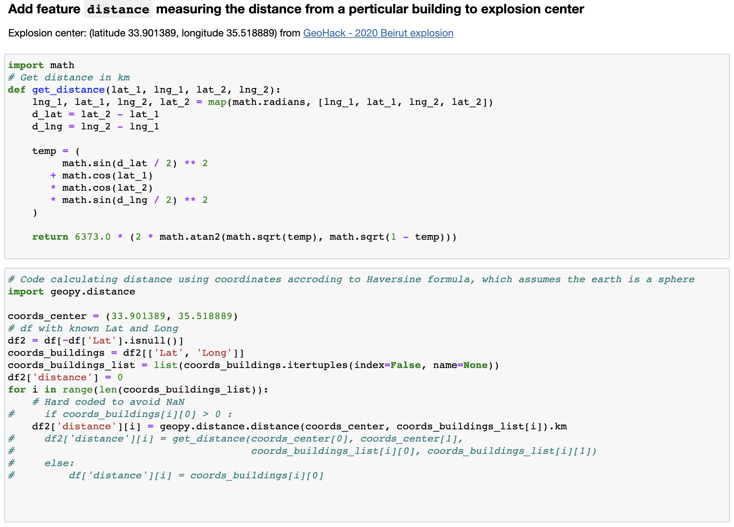
Progress3 Exploratory data analysis

Slide 17
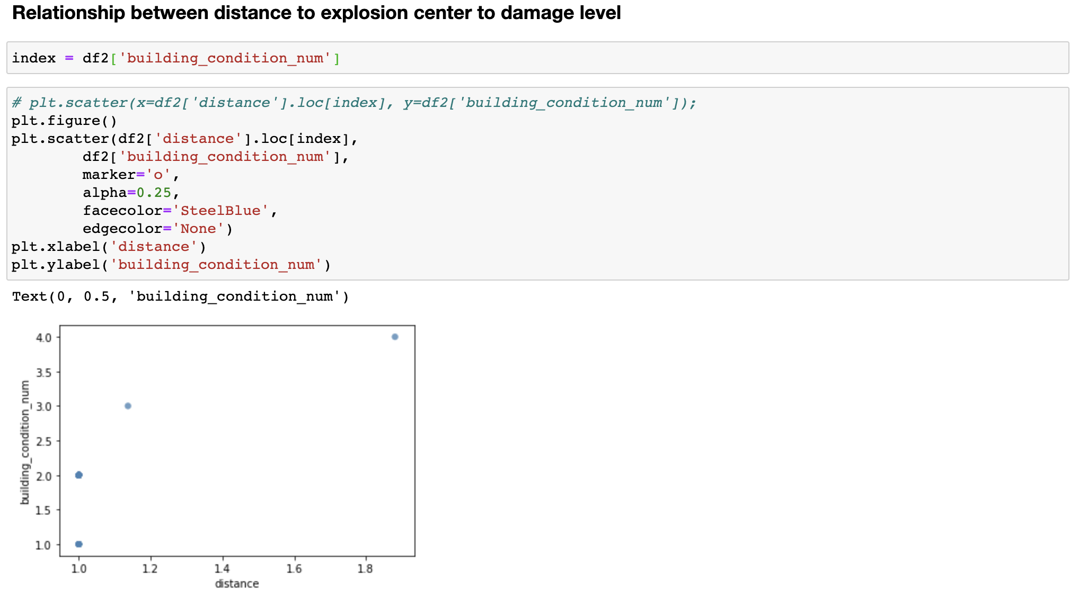
Progress3 Exploratory data analysis

Slide 18
Plan for next week
Building damage and influence analysis for Beirut explosion
1. Build machine learning models to predict building damage level.
2. Look at NASA Maps Beirut Blast Damage(https://www.nasa.gov/feature/jpl/nasa-maps-beirut-blast-damage) and see how they estimate buildings damage.
3. Ask Jinzhu about hierarchical bayesian model for prediction.

